Slide 1

Financial Analytics
Based on bank loan

Slide 2
Inside The Data Set
1.Loan amount:- The amount given by bank to customer for loan.
2.Emp-length:- company’s which took loan from bank.
3.Issue-date:- year from loan has been given
4.Home-ownership:- weather the customer took loan for rent, ownership, or mortgage.
5.Verification status:- weather the background of customer before loan approval is verified or not verified.
6.Loan duration:- month wise loan duration.
7.State:- In USA country the states which are client of bank.

Slide 3
Some Key Points
Total loan amount :- 446M
01
Total payment done :- 482.70M
02
Total revolve balance :- 532M
03
Loan durations :- 36 months and 60 months
04
Total funded amount :- 453M
05

Slide 4
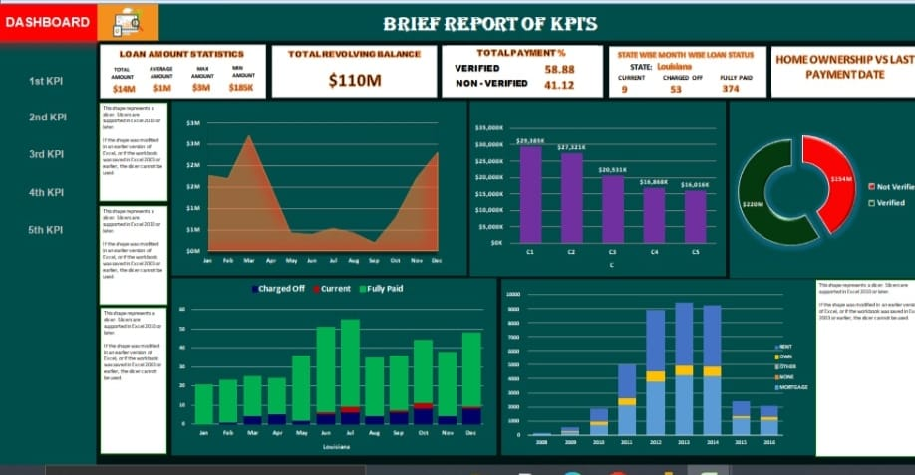
Analysis - I

Slide 5
Observation
States | Loan amount | Total payment | Revolve Balance
California | 27M | 28.89M | 27M
New-York | 28M | 30.52M | 36M
Texas | 21M | 22.29M | 25M
Florida | 11M | 11.91M | 10M
New-Jersy | 13M | 14.44M | 18M

Slide 6
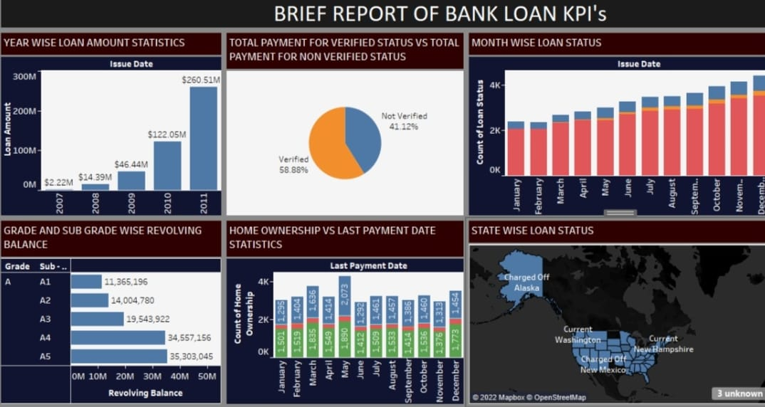
Analysis-II

Slide 7
Term Wise Analysis
For 60 months
State | Loan amount | Total payment | Revolve balance
California | 27M | 28.89M | 27M
New-York | 15M | 16.47M | 14M
Texas | 11M | 12.71M | 10M
Florida | 11M | 11.91M | 10M
New-Jersy | 8M | 9.23M | 8M

Slide 8
Term wise Analysis
For 36 months
State | Loan amount | Total Payment | Revolve balance
California | 53M | 56.74M | 70M
New-Jersy | 28M | 30.52M | 36M
Texas | 21M | 22.29M | 25M
Florida | 19M | 20.46M | 27M
New-York | 13M | 14.44M | 18M

Slide 9
Observations
Loan amount trended up, resulting in a 11.638.09%, increase between 2007 and 2011.
Loan amount started trending up in 2007 raising by 11.638.09% in 5 years.
Loan amount jump from 2219275 to 26650075 during its steepest incline between 2007 and 2011.
The revolve balance is higher in 2011 it has increased 21% from 2007 to 2011 by grade A and B the most in overall grade.
Top 5 cities has taken highest loan amount in the USA and contributed 63% in generating revenue for bank.

Slide 10
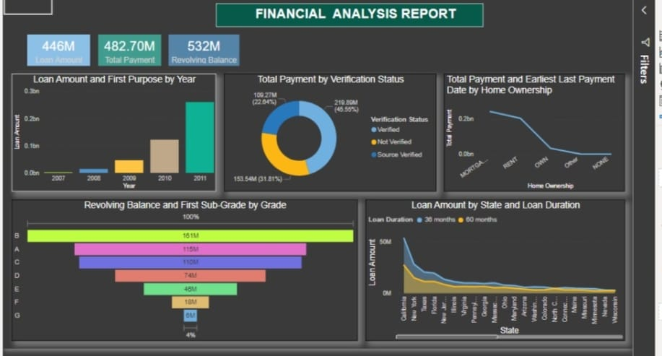
Analysis-III

Slide 11
Purpose Wise Analysis
Purpose | Loan Amount | No of Accounts Open | Year
Debt consolidation | 23M | 18K | 2011
Credit Card | 60M | 5K | 2011
Home improvement | 34M | 28K | 2011
Others | 32M | 35K | 2011
Car | 25M | 15K | 2011

Slide 12
Analysis IV
States | Funded amount | Total payment | Verified status | Non-Verified
California | 78M | 48M | 85K(17%) | 85K(17.3%)
New-York | 21M | 48.27M | 46K(9.73%) | 46.9K(9.76%)
Texas | 31M | 48.27M | 34K(7.25%) | 34.5K(7.27%)
Florida | 30M | 48.70M | 32K(6.71%) | 32.8K(6.96%)
New-Jersy | 21M | 48.27M | 23.6K(4.9%) | 23.5K(5%)

Slide 13
Observation
Verified accounted for 45.55% of total payment had done.
Mortgage had the highest total payment of 243,275,744.04 and was 12,76,714% higher than none which had lowest total payment.
Across all 5 home-ownership, total payment range from 1953.33 to 24,3275.744.
California in loan duration made up 11.96% of loan amount.
Average Loan amount was higher for 36 months 5,696,246 than 60 months 3,871,780,81.
Loan amount for 36 months and 60 months diverged the most when the state was California. When 36 months were 26,216,725 higher than 60 months in 2011.

Slide 14
Conclusion
From 2007 to 2011 the highest pick for loan amount was in the top 5 states of USA it generates 63% of revenue.
The revolve balance get decease from grade A to grade G. but according to the results in 2011 revolve balance has highest amount of 532 M and it results on the performance and revenue of bank. So to avoid it this mandatory to checked the verification status and to increase the recovery.
Though the loan duration for 36 months are having highest total payment received as compared to loan duration of 60 months so to increase the % of customers applying for loan duration of 60 months the principle interest should 4.5% to 5% for the loan amount.

Slide 15


